Slide 1
Let's get Func<Y>
Adding functional programming to your OOP codebase
Dennis Dietrich Software Engineer
Rev. 1 (2023-07-??), https://github.com/dennisdietrich/FpWithCSharp/

Slide 2
Overview
Orders of functions
Pure functions
Functional programming (FP)
Closures
Examples
Next steps and further resources

Slide 3
But before we start…
Who here is already using functional programming?
Who here is using LINQ?
sessions.Where(s => s.Title.Contains("C#"))
.Select(s => s.Speaker)
.Distinct();

Slide 4
Orders of functions

Slide 5
Orders of functions First-order functions
// First-order functions take and return data // Examples:
public static DateTime SpecifyKind(DateTime value, DateTimeKind kind) public static int Count<TSource>(this IEnumerable<TSource> source)
// Instance method with hidden this parameter public char[] ToCharArray()
// Empty parameter list and void are data too
public static void Clear()

Slide 6
Orders of functions Higher-order functions (HOFs)
// HOFs take at least one function or return a function // Examples:
public static IEnumerable<TResult> Select<TSource, TResult>( this IEnumerable<TSource> source, Func<TSource, TResult> selector) public Lazy(Func<T> valueFactory)
public static IServiceCollection AddTransient<TService>( this IServiceCollection services, Func<IServiceProvider, TService> implementationFactory) where TService : class

Slide 7
Pure functions

Slide 8
Pure functions Definition
Always produce the same output for a given set of arguments
Never have side effects

Slide 9
Pure functions Side effects
Mutating global state
Mutating arguments
Performing I/O
Throwing exceptions

Slide 10
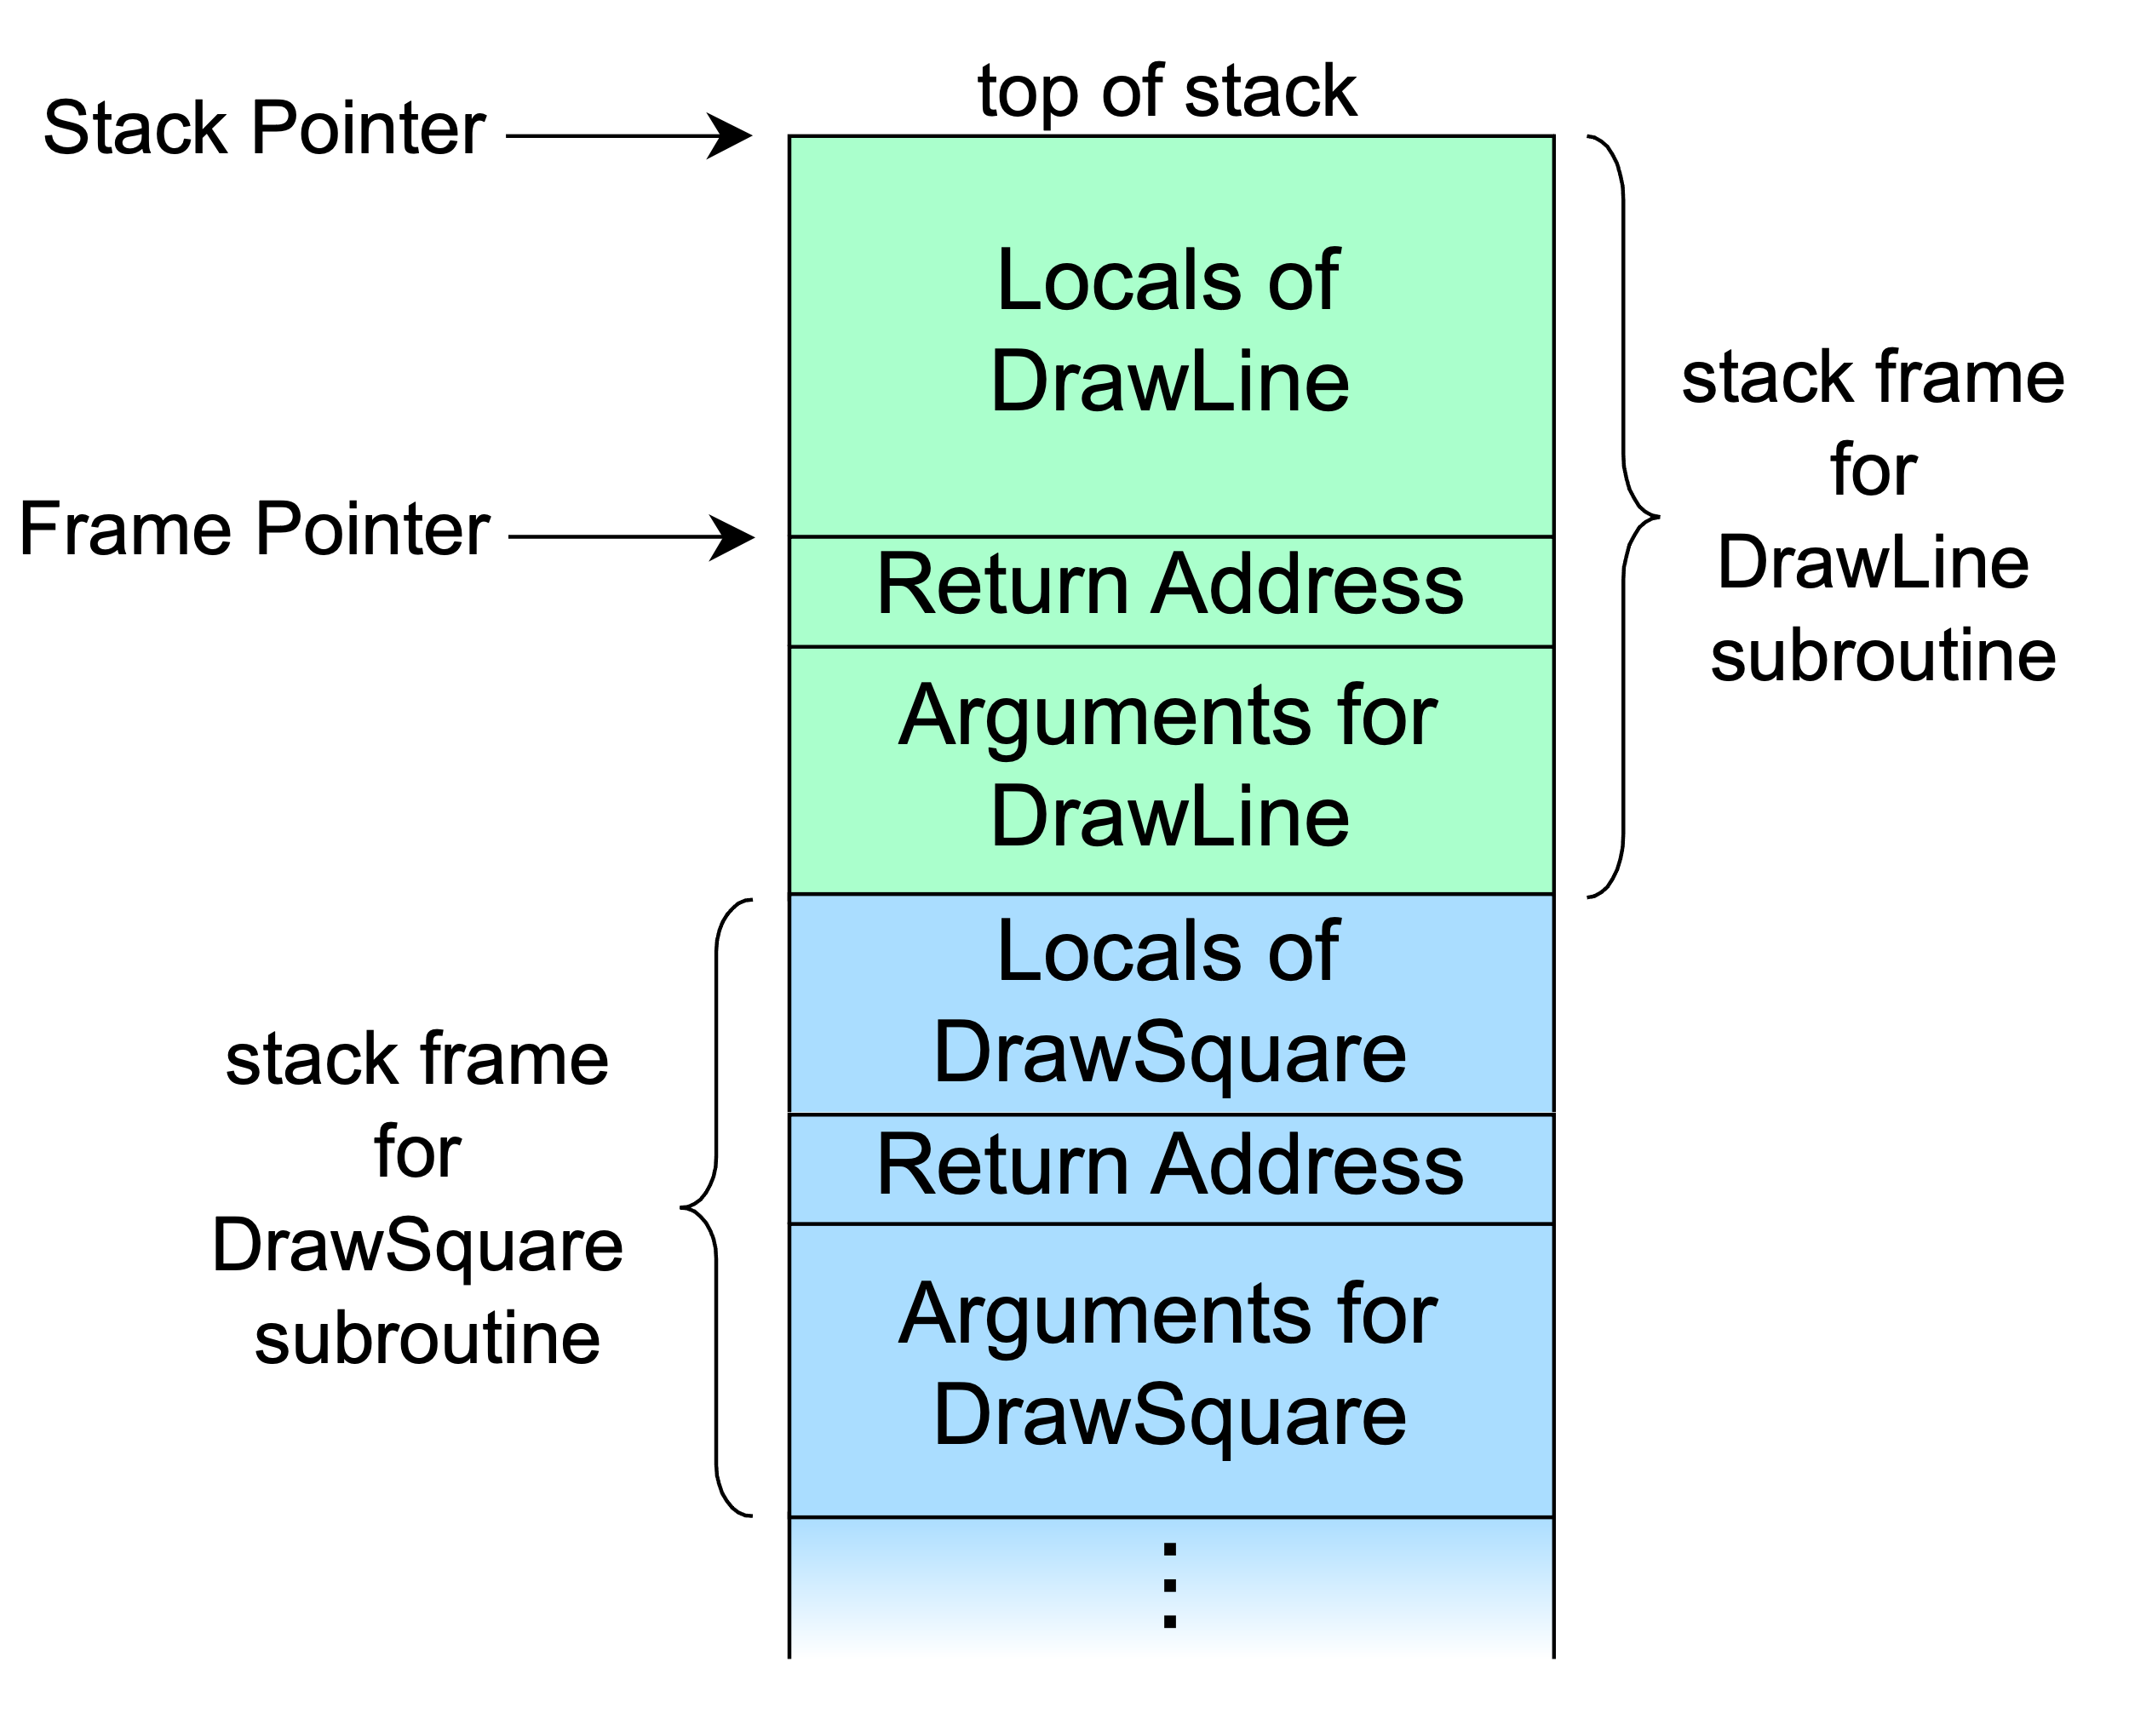
Pure functions Why are exceptions side effects?
Exceptions alter only control-flow, not state…
…unless you also consider “hidden” state (and you should)

Slide 11
Pure functions Immutability
Don‘t rely on immutability by convention
Easy to violate accidentally
Values captures in closures my be modified elsewhere
Worse yet, modification may happen during execution of pure function!
Easy to circumvent intentionally
Use immutable record types (C# 9 and later)…
…or hand-written immutable types (C# 8 and earlier)
Should return immutable object
Necessitates more memory copy operations

Slide 12
Pure functions - Sidebar When to optimize I
“Only when it’s worth it!” - Captain Obvious
Things to consider for each case:
Current cost
Expected performance improvement
Level of code churn
Estimated engineering effort
The maintainability hit is acceptable

Slide 13
Pure functions - Sidebar When to optimize II
Example scenario 1: You are not Facebook… like, at all!
Compute spend: $ 1,000 per month
Expected improvement: 10 %
Level of code churn: high (several substantial commits per month)
Estimated effort: $ 6,000
Worth it? No, certainly not!
Expected annual savings: $ 1,200
Payback period: 5 years

Slide 14
Pure functions - Sidebar When to optimize III
Example scenario 2: You are Facebook! …or Google, or Microsoft…
Compute spend: $ 1,000,000 per month
Expected improvement: 5 %
Level of code churn: low (a few minor commits per year)
Estimated effort: $ 100,000
Worth it? Yes, absolutely!
Expected annual savings: $ 600,000
Payback period: 2 months

Slide 15
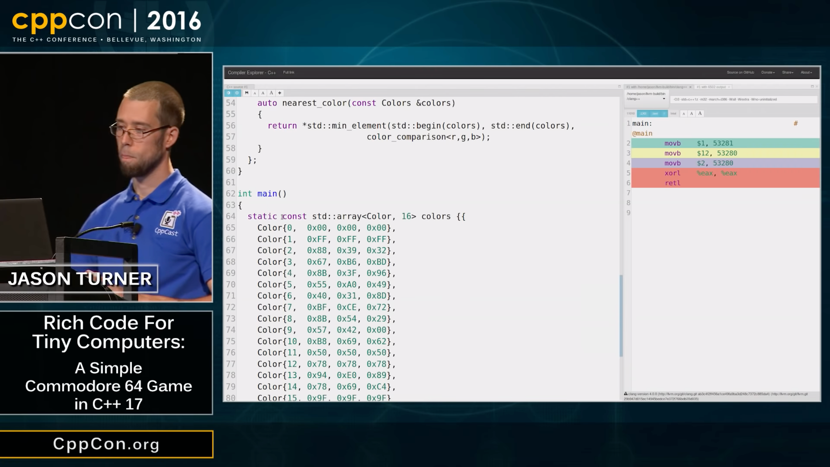
Pure functions Advantages
Better testability
Can always be memoized
Thread safety
Compile-time function execution
Rich Code for Tiny Computers: A Simple Commodore 64 Game in C++17 Jason Turner, CppCon 2016 https://www.youtube.com/watch?v=zBkNBP00wJE

Slide 16
Functional programming

Slide 17
Functional programming (FP) Definition I
“Functional programming is programming using pure functions that manipulate immutable values.” - Michał Płachta, Grokking Functional Programming
”Functional programming is sometimes treated as synonymous with purely functional programming, a subset of functional programming which treats all functions as deterministic mathematical functions, or pure functions.” - Wikipedia, Functional programming
“In computer science, purely functional programming usually designates a programming paradigm […] that treats all computation as the evaluation of mathematical functions.” - Wikipedia, Purely functional programming

Slide 18
Functional programming (FP) Definition II
“At a high level, it’s a programming style that emphasizes functions while avoiding state mutations.” - Enrico Buonanno, Functional Programming in C#
“In computer science, functional programming is a programming paradigm where programs are constructed by applying and composing functions.” - Wikipedia, Functional programming
“Functional programming is programming in a language that has first-class functions by defining and composing higher-order functions.” - Dennis Dietrich, Let's get Func<Y>

Slide 19
Functional programming (FP) Pattern matching
Supported in most functional languages including C# (since version 7, extended several times since then)
For example, not supported in JavaScript…
…but there’s an active proposal currently in stage 1 https://github.com/tc39/proposal-pattern-matching
Common feature of functional-first languages
“This article is about pattern matching in functional programming.” - Wikipedia, Pattern matching
“…” - Wikipedia, Functional programming

Slide 20
Closures

Slide 21
Closures Partial application

Slide 22
Recap Kinds of functions
Order: First or higher
Purity: Pure or Impure
Variable capturing: Is it a closure

Slide 23
Examples

Slide 24
Examples Adding optional logging

Slide 25
Example - Adding optional logging The problem I
public sealed class HighLevelCallerNoTracing { private readonly LowLevelApiNoTracing _lowLevelApi = new(); public void Foo() { foreach (var file in _lowLevelApi.GetExpiredFiles()) ProcessExpiredFile(file); } // Dummy so we have something to call
// representing further business logic private void ProcessExpiredFile(FileInfo info) { } }

Slide 26
Example - Adding optional logging The problem II
public sealed class LowLevelApiNoTracing { public TimeSpan DefaultTtl { get; set; } public IList<FileInfo> GetExpiredFiles() => GetAllFiles().Where(f => { var effectiveTtl = EffectiveTtl(f); var lastAccess = File.GetLastAccessTimeUtc(f.FullName); var isExpired = lastAccess + effectiveTtl < DateTime.UtcNow; // What if we want to trace here? return isExpired; }).ToList(); // Dummies so we have something to call representing further business logic private IEnumerable<FileInfo> GetAllFiles() => Enumerable.Empty<FileInfo>(); private TimeSpan EffectiveTtl(FileInfo file) => DefaultTtl; }

Slide 27
Example - Adding optional logging OOP solution I
public sealed class HighLevelCallerWithLogger { private readonly LowLevelApiWithLogger _lowLevelApi = new(); public ILogger Logger { get; set; } public void Foo() { foreach (var file in _lowLevelApi.GetExpiredFiles(Logger)) ProcessExpiredFile(file); } // Dummy so we have something to call
// representing further business logic private void ProcessExpiredFile(FileInfo info) { } }

Slide 28
Example - Adding optional logging OOP solution II
public IList<FileInfo> GetExpiredFiles(ILogger? logger = null) => GetAllFiles().Where(f => { var effectiveTtl = EffectiveTtl(f); var lastAccess = File.GetLastAccessTimeUtc(f.FullName); var isExpired = lastAccess + effectiveTtl < DateTime.UtcNow; logger?.LogTrace(
"File {0} with access time {1} and TTL {2} has {3}expired",
f.FullName,
lastAccess,
effectiveTtl,
isExpired ? "" : "not "); return isExpired; }).ToList();
Notes:
Low-level API now has a dependency on ILogger defined in Microsoft.Extensions.Logging.Abstractions when it really shouldn’t.

Slide 29
Example - Adding optional logging Functional solution I
public delegate void Logger(string message, params object?[] args); public IList<FileInfo> GetExpiredFiles(Logger? logger = null) => GetAllFiles().Where(f => { var effectiveTtl = EffectiveTtl(f); var lastAccess = File.GetLastAccessTimeUtc(f.FullName); var isExpired = lastAccess + effectiveTtl < DateTime.UtcNow; logger?.Invoke(
"File {0} with access time {1} and TTL {2} has {3}expired",
f.FullName,
lastAccess,
effectiveTtl,
isExpired ? "" : "not "); return isExpired; }).ToList();

Slide 30
Example - Adding optional logging Functional solution II
private readonly LowLevelApiWithFunction _lowLevelApi = new(); public ILogger Logger { get; set; } public void Foo() { foreach (var file in _lowLevelApi.GetExpiredFiles(Logger.LogTrace)) ProcessExpiredFile(file); }

Slide 31
Example - Adding optional logging Functional solution III
private readonly LowLevelApiWithFunction _lowLevelApi = new(); public void Foo() { foreach (var file in _lowLevelApi.GetExpiredFiles(WriteTrace)) ProcessExpiredFile(file); } private static void WriteTrace(
string message, params object?[] args) => Trace.WriteLine(string.Format(message, args));

Slide 32
Examples Keeping things DRY

Slide 33
Example - Keeping things DRY The problem I
public sealed record Session(string Speaker, string Title); var session = new Session(
"Dennis Dietrich",
"So you think you know functions"); WriteToJsonFile("session.json", session); WriteToTxtFile("session.txt", session);

Slide 34
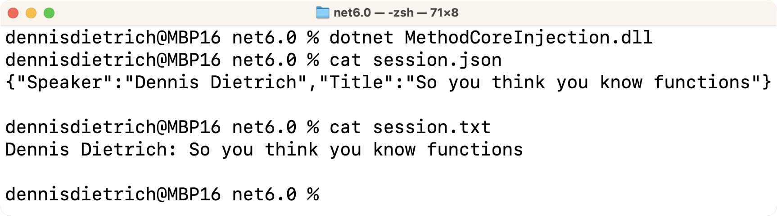
Example - Keeping things DRY The problem II
public static void WriteToJsonFile(string filename, Session session) { using var fileStream = new FileStream(filename, FileMode.CreateNew); JsonSerializer.Serialize(fileStream, session); File.SetAttributes(filename, FileAttributes.ReadOnly); } public static void WriteToTxtFile(string filename, Session session) { using var fileStream = new FileStream(filename, FileMode.CreateNew); using var streamWriter = new StreamWriter(fileStream); streamWriter.Write($"{session.Speaker}: {session.Title}"); File.SetAttributes(filename, FileAttributes.ReadOnly); }

Slide 35
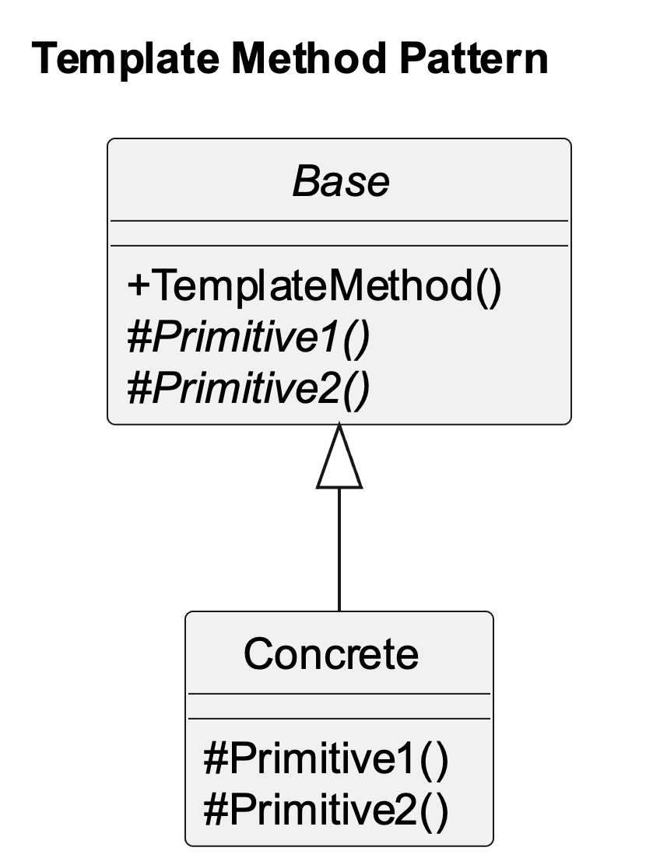
Example - Keeping things DRY The problem III
public static void WriteToJsonFile(string filename, Session session) { using var fileStream = new FileStream(filename, FileMode.CreateNew); JsonSerializer.Serialize(fileStream, session); File.SetAttributes(filename, FileAttributes.ReadOnly); } public static void WriteToTxtFile(string filename, Session session) { using var fileStream = new FileStream(filename, FileMode.CreateNew); using var streamWriter = new StreamWriter(fileStream); streamWriter.Write($"{session.Speaker}: {session.Title}"); File.SetAttributes(filename, FileAttributes.ReadOnly); }

Slide 36
Example - Keeping things DRY OOP solution I
public abstract class FileWriter<T> { public void CreateNew(string filename, T content) { using var fileStream = new FileStream(filename, FileMode.CreateNew); CreateNewImpl(fileStream, content); File.SetAttributes(filename, FileAttributes.ReadOnly); } protected abstract void CreateNewImpl(FileStream fileStream, T session); }

Slide 37
Example - Keeping things DRY OOP solution II
public sealed class JsonFileWriter<T> : FileWriter<T>
{ protected override void CreateNewImpl(FileStream fileStream, T session) => JsonSerializer.Serialize(fileStream, session); } public sealed class SessionTxtFileWriter : FileWriter<Session>
{ protected override void CreateNewImpl(FileStream fileStream,
Session session)
{ using var streamWriter = new StreamWriter(fileStream); streamWriter.Write($"{session.Speaker}: {session.Title}"); } }

Slide 38
Example - Keeping things DRY Functional solution
public static void CreateNewFile(string filename, Action<FileStream> action) { using var fileStream = new FileStream(filename, FileMode.CreateNew); action(fileStream); File.SetAttributes(filename, FileAttributes.ReadOnly); } public static void WriteToJsonFile<T>(string filename, T session) => CreateNewFile(filename, s => JsonSerializer.Serialize(s, session)); public static void WriteToTxtFile(string filename, Session session) => CreateNewFile(filename, s => { using var streamWriter = new StreamWriter(s); streamWriter.Write($"{session.Speaker}: {session.Title}"); });

Slide 39
TODO
Add reference to “hole-in-the-middle” and ”method-core injection”

Slide 40
Example - Keeping things DRY The problem reloaded
What if we want to add
optional exception handling?

Slide 41
Example - Keeping things DRY OOP solution reloaded I
public sealed class IOExceptionHandler : IExceptionHandler<IOException> { public bool Handle(IOException e) { Console.WriteLine(e); return false; } }
var handler = new IOExceptionHandler(); new JsonFileWriterWithExceptionHandling<Session, IOException>
{ ExceptionHandler = handler }.CreateNew("session.json", session); new SessionTxtFileWriterWithExceptionHandling<IOException>
{ ExceptionHandler = handler }.CreateNew("session.txt", session);

Slide 42
Example - Keeping things DRY OOP solution reloaded II
public abstract class FileWriterWithExceptionHandling<TCont, TEx>
where TEx : Exception { public IExceptionHandler<TEx>? ExceptionHandler { get; init; } public void CreateNew(string filename, TCont content) { try { using var fileStream = new FileStream(filename, FileMode.CreateNew); CreateNewImpl(fileStream, content); File.SetAttributes(filename, FileAttributes.ReadOnly); } catch (TEx e) when (ExceptionHandler != null) { if (ExceptionHandler.Handle(e)) throw; } } protected abstract void CreateNewImpl(FileStream fileStream, TCont session); }

Slide 43
Example - Keeping things DRY Functional solution reloaded I
public static void CreateNewFile(string filename, Action<FileStream> action) { using var fileStream = new FileStream(filename, FileMode.CreateNew); action(fileStream); File.SetAttributes(filename, FileAttributes.ReadOnly); } public static void WriteToJsonFile<T>(string filename, T session) => CreateNewFile(filename, s => JsonSerializer.Serialize(s, session)); public static void WriteToTxtFile(string filename, Session session) => CreateNewFile(filename, s => { using var streamWriter = new StreamWriter(s); streamWriter.Write($"{session.Speaker}: {session.Title}"); });
Nothing needs
to change!

Slide 44
Example - Keeping things DRY Functional solution reloaded II
public static void CreateNewFile(string filename, Action<FileStream> action) { using var fileStream = new FileStream(filename, FileMode.CreateNew); action(fileStream); File.SetAttributes(filename, FileAttributes.ReadOnly); } public static void WriteToJsonFile<T>(string filename, T session) => CreateNewFile(filename, s => JsonSerializer.Serialize(s, session)); public static void WriteToTxtFile(string filename, Session session) => CreateNewFile(filename, s => { using var streamWriter = new StreamWriter(s); streamWriter.Write($"{session.Speaker}: {session.Title}"); });
public static void WithExceptionHandler<T>
(Action action, Func<T, bool> handler) where T : Exception { try { action(); } catch (T e) { if (handler(e)) throw; } }

Slide 45
Example - Keeping things DRY Functional solution reloaded III
var handler = (IOException e) => { Console.WriteLine(e); return false; };
var writeToJsonFile = (string n, Session s) =>
WithExceptionHandler(() => WriteToJsonFile(n, s), handler); var writeToTxtFile = (string n, Session s) =>
WithExceptionHandler(() => WriteToTxtFile(n, s), handler); writeToJsonFile("session.json", session); writeToTxtFile("session.txt", session);

Slide 46
“Disadvantages” of FP - Sidebar
Performance
Memory copy overhead
Heap allocations
Level of abstraction
Higher (or at least different)
Combined with other abstract concepts
Not as popular as OOP

Slide 47
Examples Generator

Slide 48
Example - Generator The problem
Write a generator that outputs an infinite
sequence of DateTime values with a given interval

Slide 49
Example - Generator OOP solution I
public interface IGenerator<T> { public bool GetNext(out T next); }

Slide 50
Example - Generator OOP solution II
public class TimeGenerator : IGenerator<DateTime> { private readonly int _interval; private DateTime _next; public TimeGenerator(DateTime start, int interval) { if (interval < 1) throw new ArgumentOutOfRangeException(
nameof(interval), "Interval must be greater than zero."); _next = start; _interval = interval; }

Slide 51
Example - Generator OOP solution III
public bool GetNext(out DateTime next) { var current = _next; try { _next = _next.AddSeconds(_interval); } catch (ArgumentOutOfRangeException) { next = default; return false; } next = current; return true; } }

Slide 52
Example - Generator OOP solution IV
const int iterations = 5; const int interval = 3; var startTime = new DateTime(2023, 01, 23, 20, 28, 0); Console.WriteLine($"Generating {iterations} times with {interval} seconds interval using custom generator implementation..."); IGenerator<DateTime> times = new TimeGenerator(startTime, interval); for (var i = 0; i < iterations; i++) { times.GetNext(out DateTime time); Console.WriteLine($"{time:u}"); }

Slide 53
TODO
Add screenshots of output to previous slide

Slide 54
Example - Generator Generator solution I
public static IEnumerable<DateTime> CreateEnumerable(
DateTime start, int interval) { if (interval < 1) throw new ArgumentOutOfRangeException(
nameof(interval), "Interval must be greater than zero."); while (true) { var nextTime = start.AddSeconds(interval); yield return start; start = nextTime; } }

Slide 55
Example - Generator Generator solution II
const int iterations = 5; const int interval = 3; var startTime = new DateTime(2023, 01, 23, 20, 28, 0); Console.WriteLine($"Generating {iterations} times with {interval} seconds interval using generator implementation..."); using IEnumerator<DateTime> times = TimeGenerator.CreateEnumerable(
startTime, interval).GetEnumerator(); for (var i = 0; i < iterations; i++) { times.MoveNext(); Console.WriteLine($"{times.Current:u}"); }

Slide 56
Example - Generator Generator solution III
[MethodImpl(MethodImplOptions.AggressiveInlining)] public static T GetNext<T>(this IEnumerator<T> enumerator) { if (!enumerator.MoveNext()) throw new InvalidOperationException(
"No more elements in sequence."); return enumerator.Current; }

Slide 57
Example - Generator Generator solution IV
const int iterations = 5; const int interval = 3; var startTime = new DateTime(2023, 01, 23, 20, 28, 0); Console.WriteLine($"Generating {iterations} times with {interval} seconds interval using generator implementation..."); using IEnumerator<DateTime> times = TimeGenerator.CreateEnumerable(
startTime, interval).GetEnumerator(); for (var i = 0; i < iterations; i++) { Console.WriteLine($"{times.GetNext():u}"); }

Slide 58
Example - Generator FP solution I
public static Func<DateTime> CreateFunction(
DateTime start, int interval) { if (interval < 1) throw new ArgumentOutOfRangeException(
nameof(interval), "Interval must be greater than zero."); return () => { var currentTime = start; start = start.AddSeconds(interval); return currentTime; }; }

Slide 59
Example - Generator FP solution II
const int iterations = 5; const int interval = 3; var startTime = new DateTime(2023, 01, 23, 20, 28, 0); Console.WriteLine($"Generating {iterations} times with {interval} seconds interval using functional implementation..."); Func<DateTime> times =
TimeGenerator.CreateFunction(startTime, interval); for (var i = 0; i < iterations; i++) Console.WriteLine($"{times():u}");

Slide 60
Example - Generator The problem reloaded
Now synchronize it!

Slide 61
Example - Generator OOP solution reloaded
public static class IGeneratorExtensions { public static IGenerator<T> Synchronized<T>(this IGenerator<T> generator) =>
new SynchronizedGenerator<T>(generator); private class SynchronizedGenerator<T> : IGenerator<T> { private readonly IGenerator<T> _target; private readonly object _syncRoot = new(); internal SynchronizedGenerator(IGenerator<T> target) => _target = target; public bool GetNext(out T next) { lock (_syncRoot) return _target.GetNext(out next); } } }

Slide 62
Example - Generator Generator solution reloaded I
// See also:
// https://codeblog.jonskeet.uk/2009/10/23/iterating-atomically/ public interface ISynchronizedEnumerator<T> : IDisposable { public bool GetNext(out T? nextValue); }

Slide 63
Example - Generator Generator solution reloaded II
public static class IEnumerableExtensions { public static ISynchronizedEnumerator<T> GetSynchronizedEnumerator<T>(this IEnumerable<T> enumerable) =>
new SynchronizedEnumerator<T>(enumerable); private sealed class SynchronizedEnumerator<T> : ISynchronizedEnumerator<T> { private readonly object _syncRoot = new(); private readonly IEnumerator<T> _enumerator; internal SynchronizedEnumerator(IEnumerable<T> enumerable) => _enumerator = enumerable.GetEnumerator(); public bool GetNext(out T? nextValue) { lock (_syncRoot) { var valueAvailable = _enumerator.MoveNext(); nextValue = valueAvailable ? _enumerator.Current : default; return valueAvailable; } } public void Dispose() => _enumerator.Dispose(); } }

Slide 64
Example - Generator FP solution reloaded I
public static Func<DateTime> CreateFunction(
DateTime start, int interval) { if (interval < 1) throw new ArgumentOutOfRangeException(
nameof(interval), "Interval must be greater than zero."); return () => { var currentTime = start; start = start.AddSeconds(interval); return currentTime; }; }
Nothing needs
to change!

Slide 65
Example - Generator FP solution reloaded II
public static Func<DateTime> CreateFunction(
DateTime start, int interval) { if (interval < 1) throw new ArgumentOutOfRangeException(
nameof(interval), "Interval must be greater than zero."); return () => { var currentTime = start; start = start.AddSeconds(interval); return currentTime; }; }
public static Func<T> Synchronized<T>(Func<T> func) { object syncRoot = new(); return () => { lock (syncRoot) return func(); }; }

Slide 66
Example - Generator FP solution reloaded III
const int iterations = 5; const int interval = 3; var startTime = new DateTime(2023, 01, 23, 20, 28, 0); Console.WriteLine($"Generating {iterations} times with {interval} seconds interval using functional implementation..."); Func<DateTime> times =
Synchronized(TimeGenerator.CreateFunction(startTime, interval)); for (var i = 0; i < iterations; i++) Console.WriteLine($"{times():u}");

Slide 67
Next steps and further resources

Slide 68
Next steps and further resources More FP with C#

Slide 69
Next steps and further resources Functional(-first) languages

Slide 70
Next steps and further resources Learning more about FP

Slide 71



Questions?
dennisdietrich
dcdietrich
@dc@social.advancedsoftware.engineering

Slide 72
Thanks for listening!
dennisdietrich
dcdietrich
@dc@social.advancedsoftware.engineering

